Slide 1

Unit 5: Lesson 3:
Working from home

Slide 2
Task 1: Name at least five jobs you can do from home.
Task 2: Will there be more or fewer people working from home in the future?
Task 3: Which items would you buy online for somebody who works from home? Your budget is £30.

Slide 3
Task 4: Zoey is talking to the office manager at her new company. Listen to the conversation and circle the correct answer.
https://www.e-sfera.hr/dodatni-digitalni-sadrzaji/0a7f0584-811b-4f3c-963a-63d914b9f25c/

Slide 4
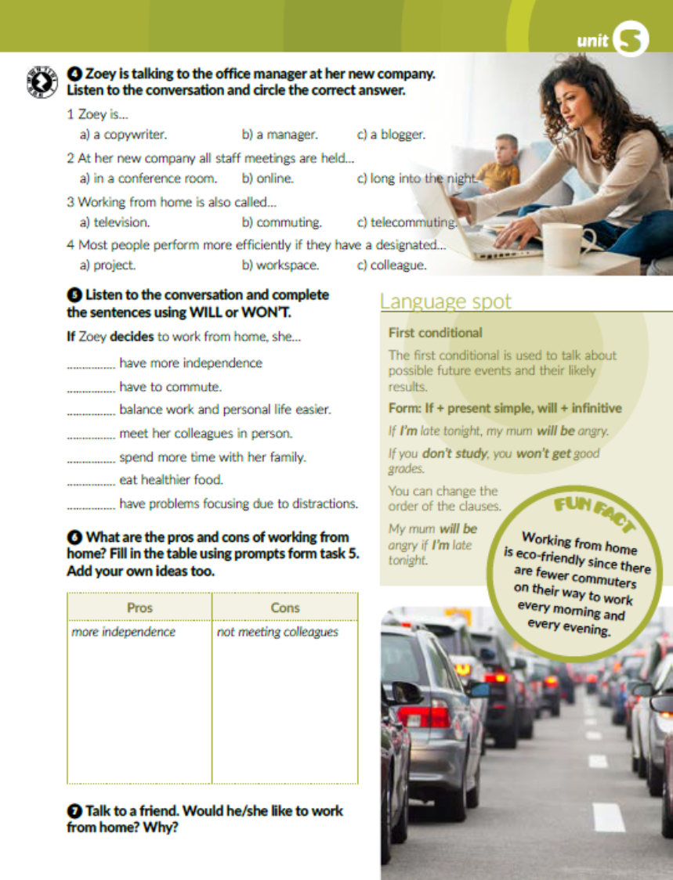
Task 5: Listen to the conversation and complete the sentences using WILL or WON’T.
https://www.e-sfera.hr/dodatni-digitalni-sadrzaji/0a7f0584-811b-4f3c-963a-63d914b9f25c/
will
won’t
will
won’t
will
will
will

Slide 5

Napiši naslov u bilježnicu – First conditional – i prepiši tekst u rubrici Language spot u bilježnicu.

Slide 6

Task 6: What are the pros and cons of working from home? Fill in the table using prompts from task 5. Add your own ideas too
not have to commute
better work and personal life balance
more time with family
eating healthier
having problems focusing
not having a designated workspace
danger of overworking oneself without satisfactory results

Slide 7
Open your workbook, page 91
Task 1: Find pairs and translate them. Pronađi parove i prevedi ih.
6
4
5
7
8
10
9
3
2
minijaturni ovlaživač zraka
gel za čišćenje tipkovnice
jastučić od memorijske pjene
registratori
podesivi radni stol
slušalice koje izoliraju buku
prijanjajući fiksatori za kablove
naočale sa zaštitom od plavog svjetla
savitljiva lampa

Slide 8
Task 2: Complete the sentences with the words from the box. Dopuni rečenice ponuđenim riječima.
staff meeting
overwork
telecommute
trivial
efficient
distraction

Slide 9
Task 3: Match the sentence parts. Poveži dijelove rečenica.
7
3
6
2
4
8
5

Slide 10
Task 4: Complete the conditional sentences using the correct form of the verbs in brackets.
take
will get
doesn’t go
won’t
don’t like
will return
will be
don’t finish
will go
has
will be
don’t call

Slide 11
Task 5: Match.
1
3
4
5

Slide 12
Task 6: Design an online shop that sells cool school supplies. Think of different products and their prices. Draw the images and colour them.

Slide 13

PLAY AND LEARN!
https://www.e-sfera.hr/dodatni-digitalni-sadrzaji/0a7f0584-811b-4f3c-963a-63d914b9f25c/

